Slide 1
Chapter 20
Network Layer Protocols:
ARP, IPv4, ICMPv4, IPv6, and ICMPv6

Slide 2
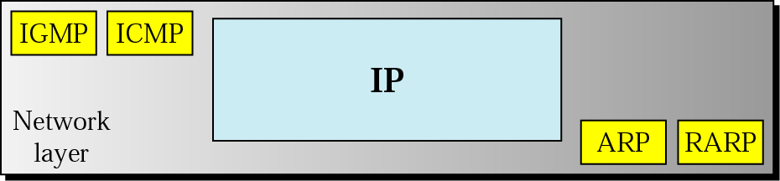
Figure 20.1 Protocols at network layer

Slide 3
20.1 ARP
Mapping
Packet Format
Encapsulation
Operation

Slide 4
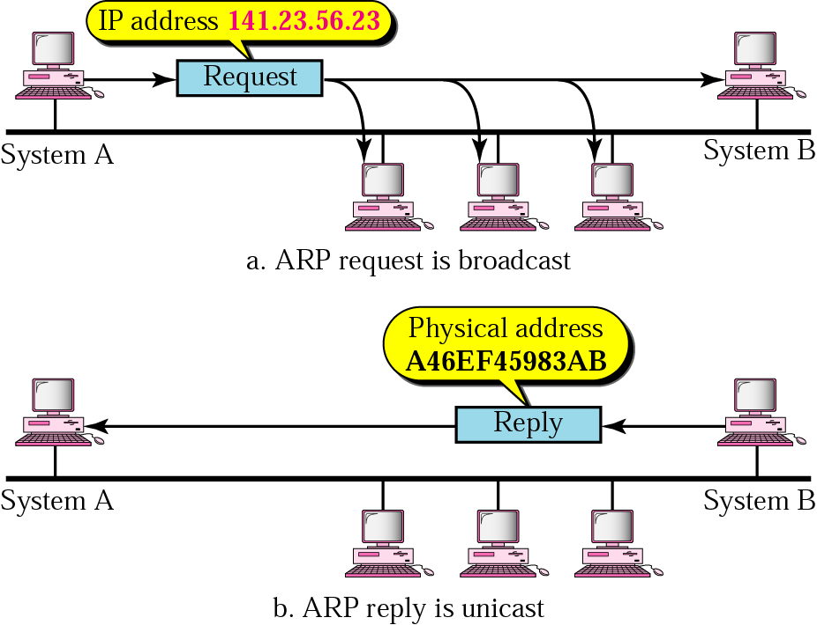
Figure 20.2 ARP operation

Slide 5
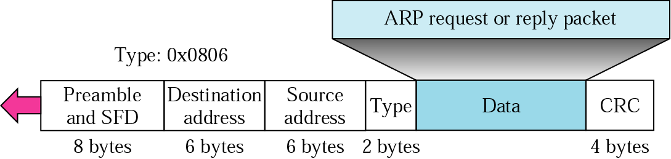
Figure 20.4 Encapsulation of ARP packet

Slide 6
Note:
An ARP request is broadcast; an ARP reply is unicast.

Slide 7
20.2 IP
Datagram
Fragmentation

Slide 8
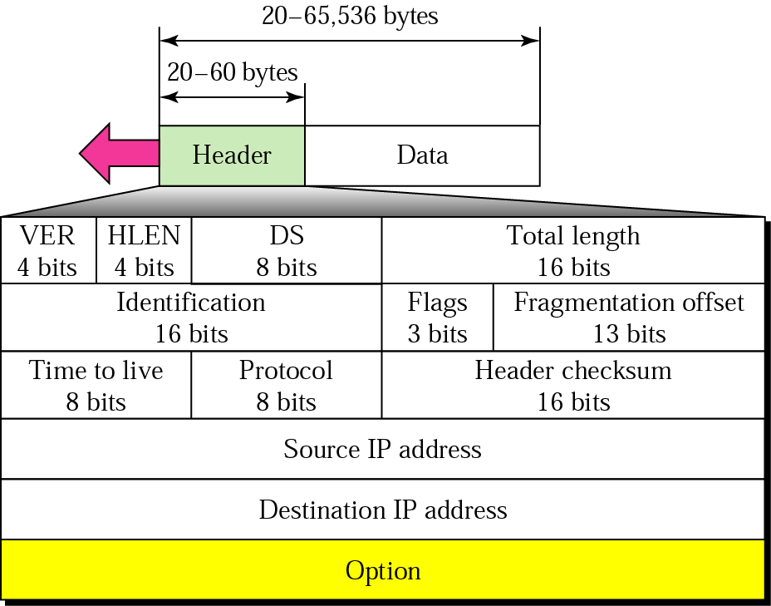
Figure 20.7 IP datagram
Fragmentation
related fields
Higher-level protocol that uses the services of the IP layer
e.g., TCP, UDP, ICMP, …

Slide 9
Note:
The total length field defines the total length of the datagram including the header.

Slide 10
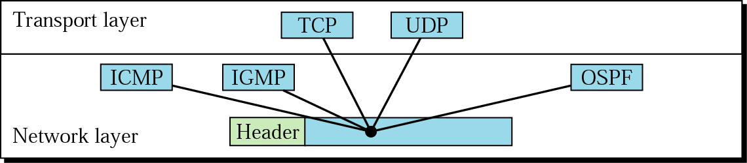
Figure 20.8 Multiplexing

Slide 11
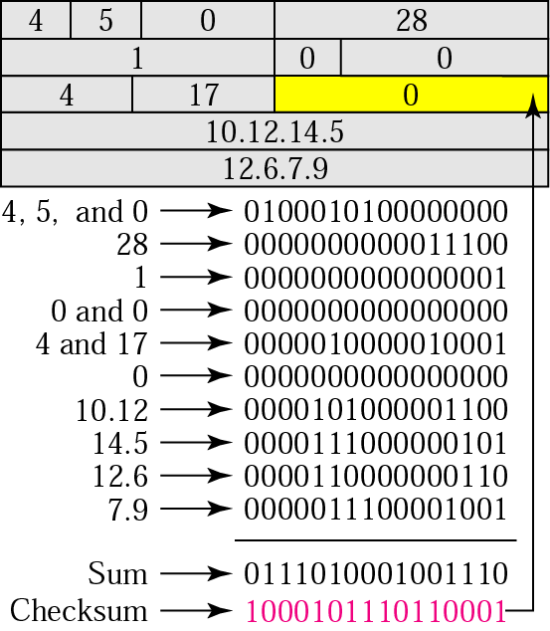
Figure 20.9 Example of checksum calculation

Slide 12
Fragmentation
Why do we need fragmentation of IP packet?
R
R
R
PC
PC
MTU=1500
MTU=500
MTU=1000
MTU=1500

Slide 13
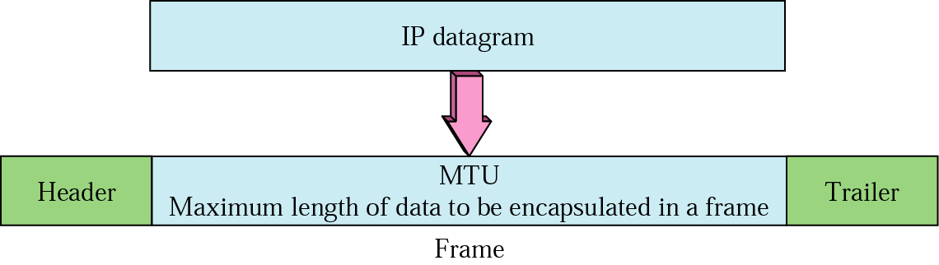
Figure 20.10 MTU

Slide 14
IP Fragmentation & Reassembly
network links have MTU (max.transfer size) - largest possible link-level frame.
different link types, different MTUs
large IP datagram divided (“fragmented”) within net
one datagram becomes several datagrams
“reassembled” only at final destination
IP header bits used to identify, order related fragments
fragmentation:
in: one large datagram
out: 3 smaller datagrams
reassembly

Slide 15
IP Fragmentation and Reassembly
3 bits
13 bits
length
=4000
ID
=x
offset
=0
Example
4000 byte datagram
MTU = 1400 bytes
Reserved
Frag./no frag.
More fragment bit
length
=1400
ID
=x
fragflag
=1
offset
=0
length
=1400
ID
=x
fragflag
=1
offset
=175
One large datagram becomes
several smaller datagrams
length
=1200
ID
=x
fragflag
=0
offset
=350
1400
0000 0101 0111 1000
Offset*8=byte offset
175
0000 0101 0111 1

Slide 16
20.3 ICMP
Types of Messages

Slide 17
ICMP
Why ICMP?
IP has no error-reporting or error-correcting mechanism. What happens if something goes wrong?
E.g., a router cannot find a router to the final destination, given a packet
IP lacks a mechanism for host and management queries
E.g., Is a router alive?

Slide 18
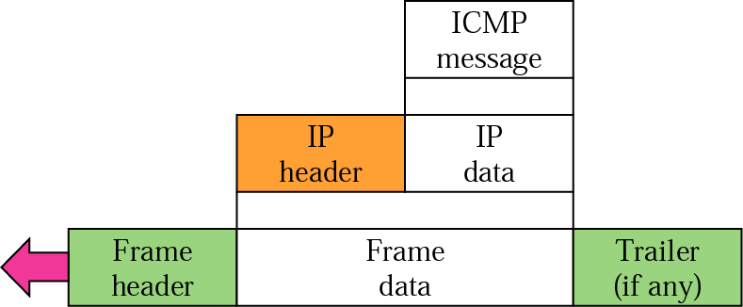
Figure 20.12 ICMP encapsulation

Slide 19
Note:
ICMP always reports error messages to the original source.

Slide 20
Error-reporting messages of ICMP (1)
Destination unreachable
When a router cannot route a datagram or a host cannot deliver a datagram
The datagram is discarded, and the router or the host sends a destination unreachable message back to the source host
Source quench
Since IP does not perform flow control and congestion control, the source host never knows if the destination host has been overwhelmed with datagrams
When a router or host discards a datagram due to congestion, it sends a source-quench message to the sender
Time exceeded
A time-exceeded message is sent to the source when
A router receives a packet with 0-valued TTL
All fragments do not arrived at a certain time limit at the destination host

Slide 21
Error-reporting messages of ICMP (2)
Parameter problem
A parameter-problem ICMP packet is sent to the source if
A router or the destination host discovers an ambiguous or missing value in any field of the datagram
Redirection
Since a host usually use static routing, the host may send a packet to the default router which may be a wrong router. In this case, if the default router knows the correct router, it sends a redirection message back to the host.

Slide 22
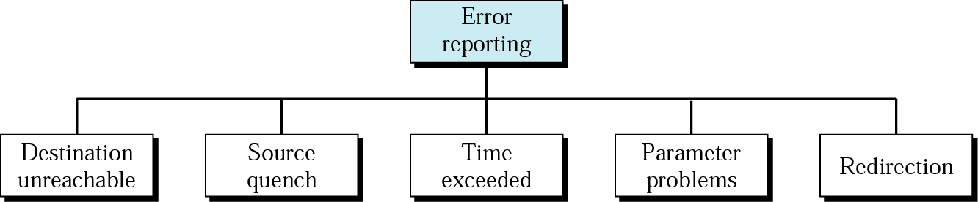
Figure 20.13 Error-reporting messages

Slide 23
Note:
There is no flow control or congestion control mechanism in IP.

Slide 24
Query in ICMP
Echo request and replay
i.e., ping ei.chonbuk.ac.kr
Time-stamp request and replay
To determine the round-trip time
Address mask request and reply
Given a address mask request message to a router, the router sends a mask in an address mask reply message
Router solicitation and advertisement
Why?
A host needs to know the address of routers connected to its own network to send data to a host on another network
Given a router solicitation message from a host, router(s) broadcast their routing information using the router-advertisement message

Slide 25
20.4 IPv6
IPv6 Addresses
Categories of Addresses
IPv6 Packet Format
Fragmentation
ICMPv6
Transition

Slide 26
IPv6 (IPng)
Advantages over IPv4
Larger address space
128 bits
Better header format
This simplifies and speeds up the routing process since most of the options are not need to be checked by routers
New options
Allowance for extension
Support for research allocation
Flow label instead of type-of-service field
Support for more security

Slide 27
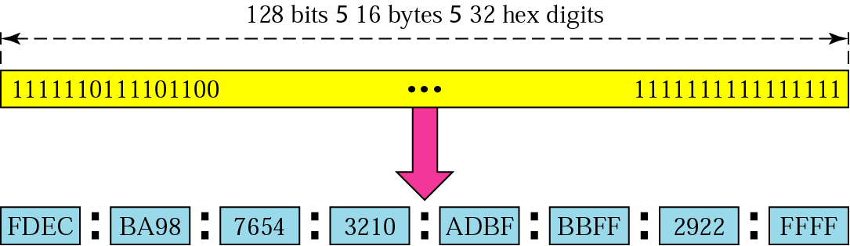
Figure 20.15 IPv6 address
Hexadecimal colon notation

Slide 28
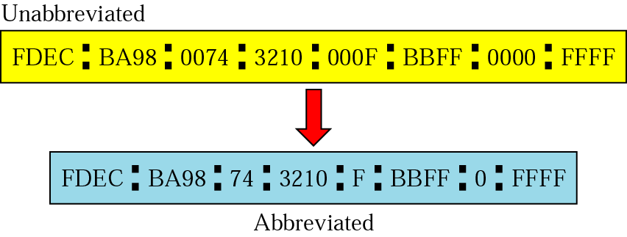
Figure 20.16 Abbreviated address

Slide 29
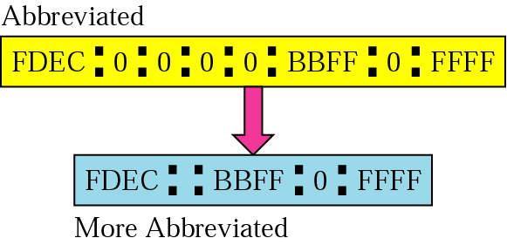
Figure 20.17 Abbreviated address with consecutive zeros

Slide 30
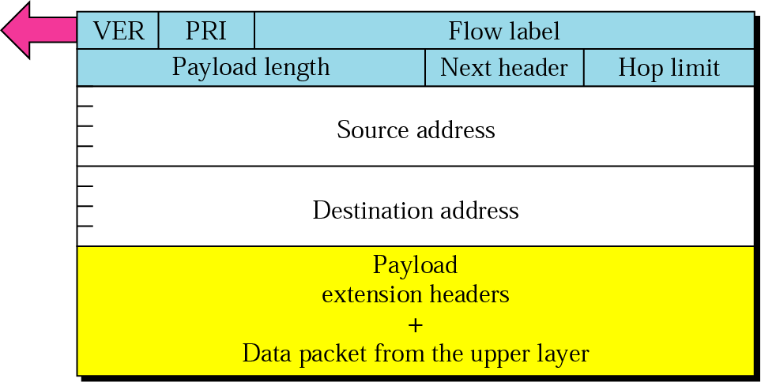
Figure 20.19 Format of an IPv6 datagram

Slide 31
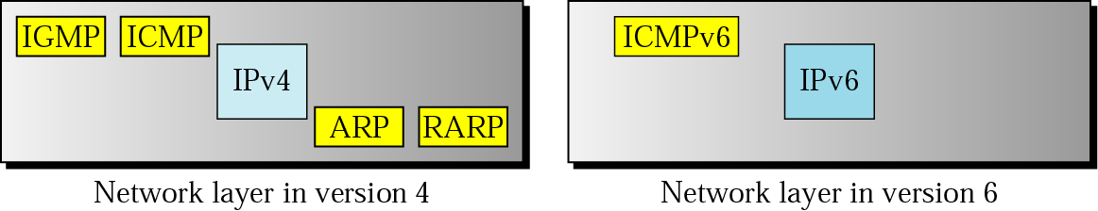
Figure 20.20 Comparison of network layers in version 4 and version 6

Slide 32
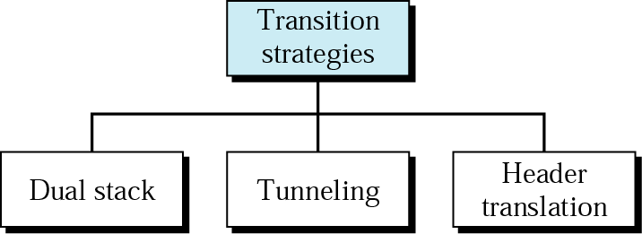
Figure 20.21 Three transition strategies

Slide 33
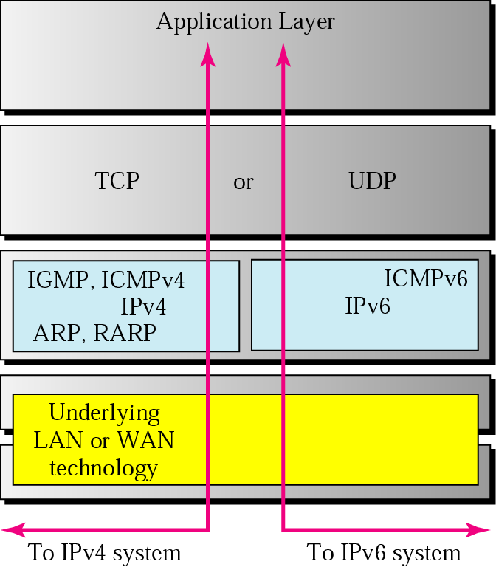
Figure 20.22 Dual stack
IPv4
IPv4
IPv6
IPv6
What problems?
X
IPv4-IPv6

Slide 34
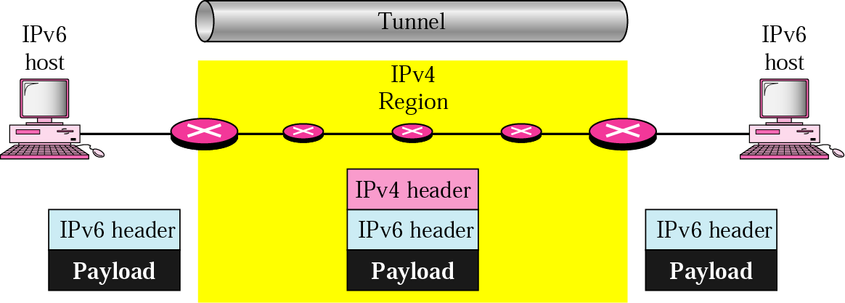
Figure 20.23 Tunneling
IPv4
IPv4
IPv4/IPv6
IPv4
IPv4
IPv4/IPv6
IPv6
IPv6

Slide 35
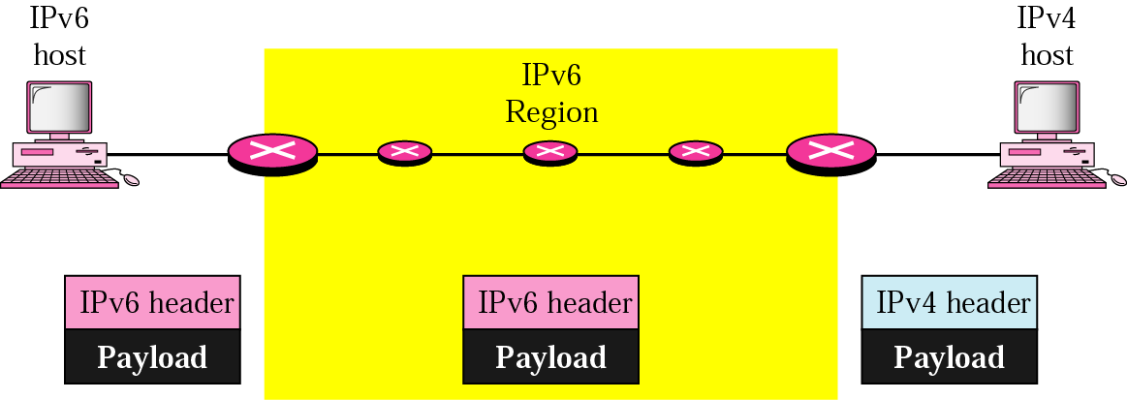
Figure 20.24 Header translation
IPv6
IPv4
IPv4-IPv6 Very limited!
IPv6 flow label problem

Slide 36
Fundamental problems for IPv6 translation
Router replacement!

